Slide 1
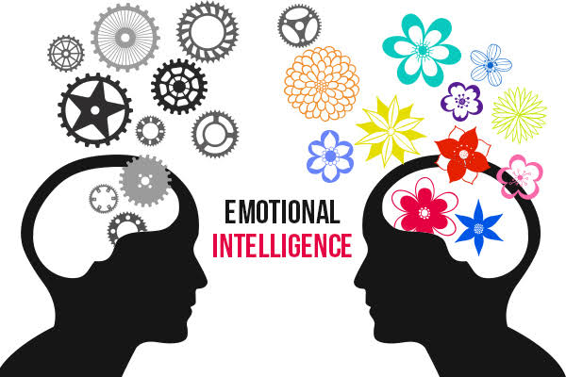

Slide 2
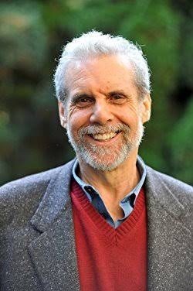
EMOTIONAL INTELLIGENCE(EI)
Emotional Intelligence; also called EI, describes an ability, capacity, or skill to perceive, assess, and manage the emotions of one’s self, of others, and of groups. The term emotional intelligence was coined by Salovey and Mayer
in 1990, but was popularised by Daniel
Goleman through his book,
“Emotional Intelligence:
Why it can matter more than IQ”.

Slide 3
EI - Meaning
According to Salovey and Mayer, emotional intelligence is a form of social intelligence that involves the ability to monitor one’s own and others’ feelings and emotions, to discriminate among them, and to use this information to guide one’s thinking and action.
Goleman defined emotional intelligence as the capacity for recognizing our own feelings and those of others, for motivating ourselves, and for managing emotions well in ourselves and in our relationship.

Slide 4
EI – The five domains
Goleman identified the five ‘domains’ of EI as:
Self awareness
Self regulation
Self motivation
Empathy
Social skills

Slide 5
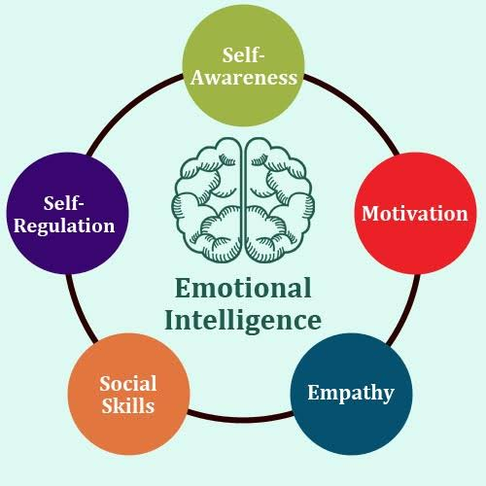

Slide 6
SELF AWARENESS
Knowing what we are feeling in the moment, and using those preference to guide our decision making; having a realistic assessment of our own abilities and a well-grounded sense of self-confidence.
Emotional awareness: Recognizing one’s emotions and their effects.
Accurate self-assessment: Knowing one’s strengths and limits.
Self-confidence: Sureness about one’s self-worth and capabilities.

Slide 7
SELF REGULATION
Handling our emotions so they facilitate rather than interfere with the task at hand; being conscientious and delaying gratification to pursue goals recovering well from emotional distress.
Self-control: Managing disruptive emotions and impulses.
Trustworthiness: Maintaining standards of honesty and integrity.
Adaptability : Flexibility in handling change.
Innovativeness: Being comfortable with and open to new ideas and new information.

Slide 8
SELF MOTIVATION
Using our deepest preferences to make and guide us toward our goals, to help us take initiative and strike to improve, and to persevere in the face of set backs and frustrations.
Achievement drive: Striving to improve or meet a standard of excellence.
Commitment: Aligning with the goals of the group or organisation.
Initiative: Readiness to act an opportunities.
Optimism: persistence in pursuing goals despite obstacles and setbacks.

Slide 9
EMPATHY
Seeing what people are feeling, being able to take their perspective and cultivating rapport and attunement with a broad diversity of people.
Service orientation: Anticipating, recognising and meeting customer’s needs.
Developing others: Sensing what others need’s in order to develop, and bolstering their abilities.
Leveraging diversity: Cultivating opportunities through diverse people.
Political awareness: Reading a group’s emotional currents and power relationships.

Slide 10
SOCIAL SKILLS
Handling emotions in relationships well and accurately reading social situations and networks; interacting smoothly using these skills to persuade and lead, negotiate and settle disputes, for co-operation and team work.
Communication: Sending clear and convincing messages.
Change catalyst: Initiating or managing change.
Conflict management: Negotiating and resolving disagreements.
Building bonds: Nurturing instrumental relationship.
Collaboration and co-operation: Working with others towards shared goals.
Team capabilities: Creating group synergy in pursuing collective goals.

Slide 11
EMOTIONAL QUOTIENT(EQ)
The term Emotional Quotient(EQ) was coined by Baron in 1988 as a counterpart to Intelligence Quotient(IQ). EQ is measure of one’s emotional intelligence, or one’s ability to use both the emotions and cognitive skills.
According to Dazier, EQ is the ability to perceive and express emotion, assimilate emotion in thought, understand and reason with emotion, and regulate emotion in the self and others.

Slide 12
COMPONENT OF EQ
Goleman identified the five ‘domains’ of EQ is
Knowing your emotions.
Managing your own emotions.
Motivating yourself.
Recognising and understand other people’s emotions.
Managing relationships .i.e.; managing the emotions of others.

Slide 13
Guidelines for promoting EI in the school paving the way.
Assessing the individual needs.
Assess the schools needs.
Delivering assessments with care.
Maximising learning choice.
Encouraging participation.
Linking goals and personal values.
Adjusting individual expectations.
Assessing readiness and motivation for EQ development.

Slide 14
Foster relationships between EQ trainers, teachers and learners.
Self-directed change and learning.
Setting goals.
Breaking goals down into achievable steps.
Providing opportunities for practice.
Give feedback
Using experimental methods.
Develop organizational culture that supports learning.
Use models and examples.
Encourage insight and self-awareness.
Encourage application of new learning in our work.

Slide 15


